Slide 1




build test publish
Project
Image
Pod
…
push code
dockerfile
trigger pipeline
deploy image
deploy pod
.gitlab.yaml
Developer
Gitlab server
Gitlab Runner
Docker Server
Rancher

Slide 2

Build-->test-->publish
Project
Image
Pod
…
push code
dockerfile
trigger pipeline
deploy image
deploy/update pod
.gitlab.yaml
Developer
Gitlab server
Gitlab Runner
Docker Server
Rancher

Slide 3

Build-->test-->publish
Project
Image
Pod
…
push code
dockerfile
trigger pipeline
deploy image
deploy/update pod
.gitlab.yaml
Developer
Gitlab server
Gitlab Runner
Docker Server
Rancher

Slide 4
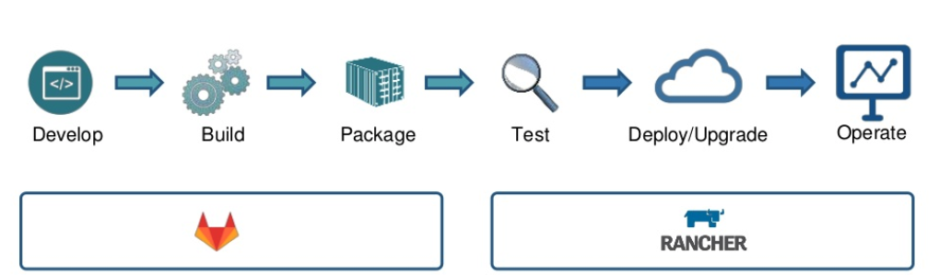
Build-->test-->publish
Developer
gitlab
Gitlab runner
私有仓库
rancher

Slide 5
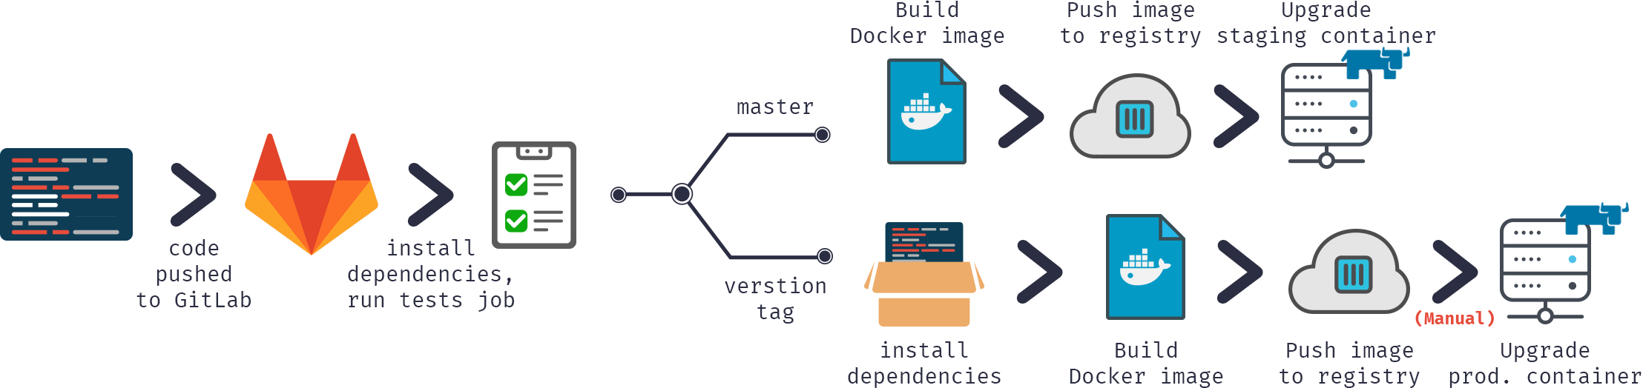

Slide 6
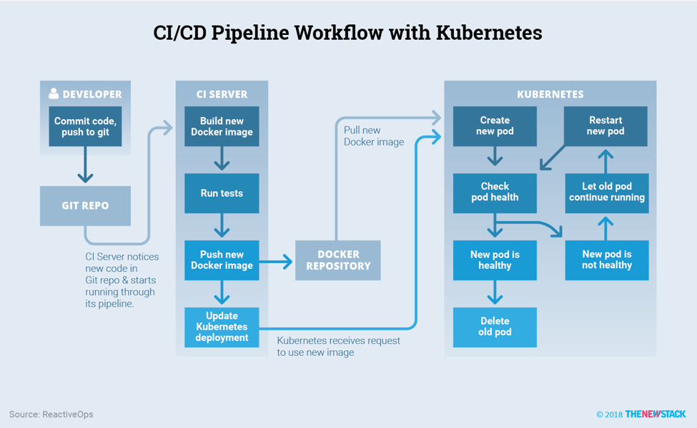

Slide 7

DEVELOPER
提交代码，
推送到gitlab
构建新的Docker镜像
创建新的pod
重新启动新的pod
Run tests
检查pod状态
之前的pod继续运行
GITLAB
推送新的Docker镜像
Docker私有仓库
新的pod正常
新的pod
不正常
删掉之前的pod

Slide 8
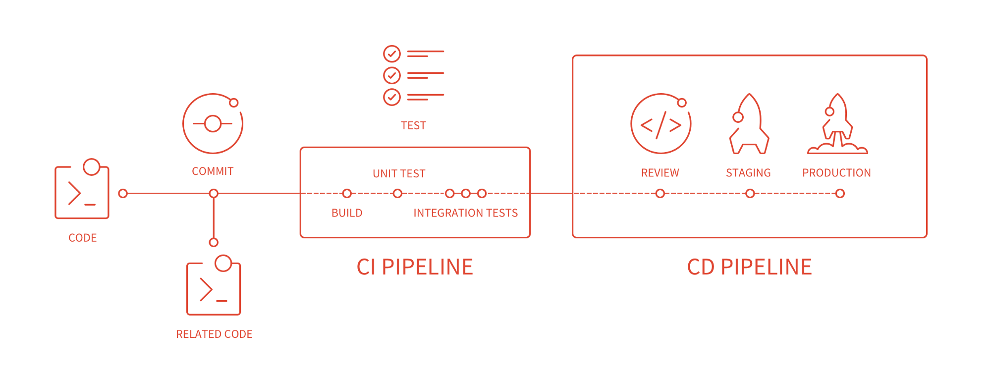

Slide 9
